Slide 1
Final project
Module:
TIC
Presentation about the tools of TIC

Slide 2
The impact of this domain
Tic -or technology and information communication-,had an undeniable impact on our field of technology.
As it enables faster and far more efficient communication, with streamlined process on collaborations and every type of personal or public projects, shaping the future of various industries.
And some popular Tic tools we’ll be discussing today include:
Word, Excel, and Powerpoint (Microsoft-office)
LaTex
Git and Github

Slide 3
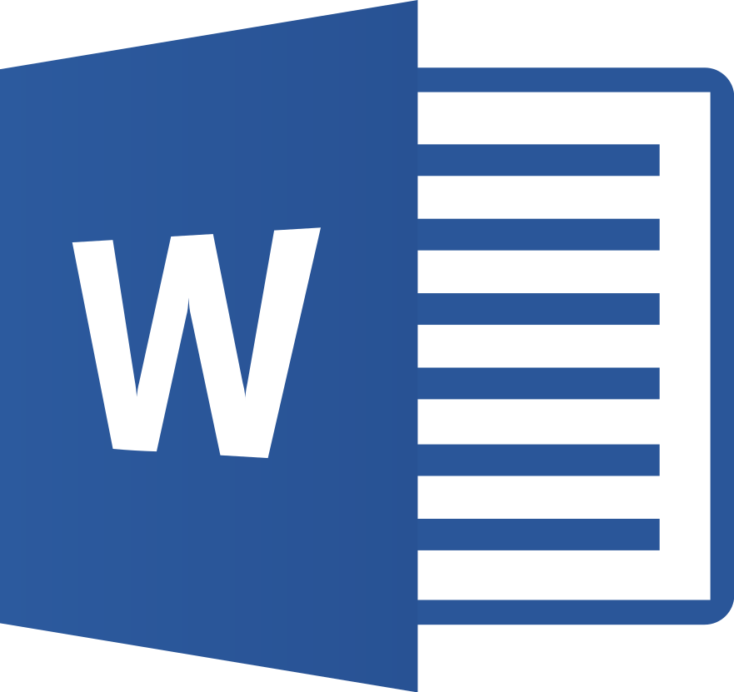
Office-word
The most used tool of the bunch
A versatile word processing program for creating, editing, formatting, and printing documents, which is ideal for personal, academic, and professional document needs. So it is utilized in in academic writing, assignments, thesis preparation, etc.
It achieves such usage with its simple yet versatile nature, as it has a simple user interface (an that can customized!) that can also be expanded to give the necessary tools for any documentation.
All this paired with the compatibility on every device made Word a first choice for every documentation around the globe.

Slide 4
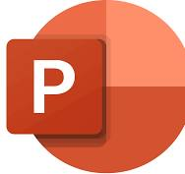
Office-POWERPOITN
PowerPoint is a presentation software for crafting dynamic presentations –slideshows, visual aids, ect- , which is an ideal tool for business pitches, educational lectures, seminars, and more.
PowerPoint was a stepping stone for Redefining Visual Communication and Engagement, since it allows creation of visually appealing slides with text, images, videos, and much more(as seen in this presentation). While it keeps it engaging with a range of transitions and animations.
And with enabling easier collabrations, PowerPoint became the most widely used tool in its area.

Slide 5
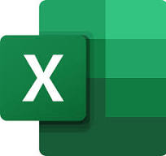
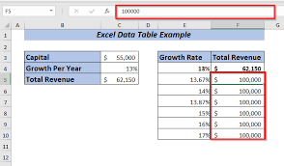
OfficE-EXCEL
Excel is what we call a spreadsheet software, made for mastering Data Analysis and Management, with tools for data organization, analysis, and calculations. So it is greatly utilized in businesses, finance, scientific research and even personal use.
Excel excels in every area you need for management, with tools ranging from comprehensive set of formulas and functions for calculations and analysis to features like sorting, filtering, and pivot tables for deeper insights.(it even has its own little programing language!)
Excel is most known for its table format
And with all those tool, Excel became the most reliable, versatile, and successful program in what it does.

Slide 6

La-Tex
The LaTex project is a typesetting system used for document preparation designed for high-quality typesetting of documents with complex structures, which is ideal for academic papers, theses, technical documents, and scientific writing.
Latex uses a markup language –like Html- to format text and structure documents that are complex and detailed, unlike Word it has exceptional support for mathematical formulas and equations and easy cross-referencing of sections, figures, and citations. Just to name a few of its impressive toolset.
Even though some consider it a niche tool, LaTex still has an impressive usage and is dominant in its domain.

Slide 7
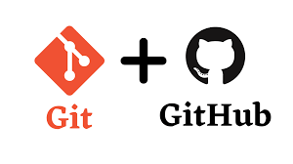
Git/github
Git is a distributed version control system for tracking changes in source code during software development which tracks changes to files, allowing users to revert to specific versions and enables parallel development through branches and seamless merging.
While GitHub is a web-based platform for hosting Git repositories, which facilitates collaboration, code review, and project management and enables open-source collaboration and contributions.
As one could tell, these tools are best used together.
Basically every project you could think of is managed with Git and GitHub, since they are the most used programs for this around the globe.

Slide 8
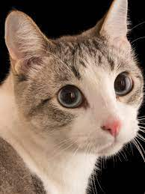
Thanks for reading.
Here is a cat
I hope our work was fitting for a last project.
Kind regards.

